Slide 1
TRANSITS I
Organisational Module
Your trainer: firstname lastname
Location cityname, country
Date dd mon year

Slide 2
Learning Objectives
Gain an overview of elements to establish a CSIRT
Discuss where a CSIRT sits within an organisation
Know how to get started
Understand key reference documents to help you

Slide 3
Session Plan
Why CSIRT ?
Starting Points & Basics
Basics & Exercise
Organisational Factors
Human Factors
Wrap-up
Notes:
{ authors to-do : add appx timings based on the experiences in 2019 }

Slide 4
Why CSIRT ?
Why incident management ?
Notes:
Trainer: in the 4MAT system (as taught in trainer-training) this is the start of the Why section. The Why is extra important for the organisational module, as this module really lays the Why foundation for the whole TRANSITS I training. Which is also the reason that whenever possible, this module should be taught first (can be done after an introductory group exercise, like the ENISA roleplay), or at least (e.g. when the training is done in 2 parallel groups) at a very early stage in the training.

Slide 5
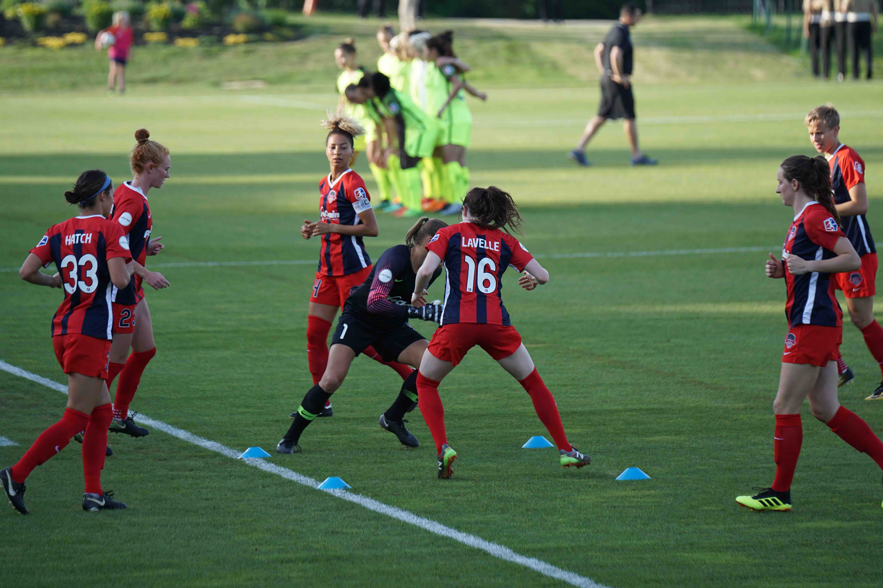
Let’s get to know each other some more
Photo by Jeffrey Lin on Unsplash
Notes:
Trainer: in a relaxed fashion (tip: come closer to your audience – use stage anchoring as in trainer-training) ask the following questions in the plenary – make your own choice, depending on the audience – add your own as you see fit :
1. Do you read more than 2-3 articles on cyber security per week?
2. Who comes from a country with a national CSIRT?
3. Who thinks vendors are responsible for the software they write?
4. Who thinks governments (should) play a role in cyber security?
5. Who thinks banks should cooperate on cyber attacks?

Slide 6

What is it you want to protect ?
Groups of 4 :
7 minutes discussion
Discuss in plenary
Photo by Samuel Zeller on Unsplash
Notes:
Trainer: create the groups (3 to max 5 per group) in such a way that they can easily move together without too much fuss – as it’s only a short exercise. Let them talk about what they, their CSIRT/CERT/SOC or whatever security team they represent, actually wants to protect. After the 7 minutes, shortly discuss in plenary. Clues as to possible replies:
Primary process
Customers, Employees, Identities
Products, Contracts
Supporting processes
Reputation
Information, infrastructure
Critical infrastructures
Health, lives
And many others options!
Highlight some of the above as you see fit, if the groups don’t mention them.

Slide 7
Internet history : need for incident management & governance
196X: ARPANET
1988: Morris Worm led to creation of CERT et al.
1996: Aleph1: “Smashing the Stack for Fun and Profit”
1984: creation of global DNS
2001: TF-CSIRT started & Budapest Convention signed
2003: World Summit on the Information Society
1998: CSIRT Handbook
1989: FIRST founded
1993: start of collaboration of teams in Europe
2000: The Millennium bug 2000: Burst of Dot-Com Bubble
2012: WCIT-12 in Dubai (governance)
2015: GFCE
2007: Cyber attack on Estonia
2005: IGF
2017: 1st IoT botnets
2010: Stuxnet
2011: Diginotar
Timeline courtesy FIRST
Notes:
Trainer: advised to explain and stress how the history and growth of the Internet led to:
the need for incident response (just putting out the fire!)
which naturally grew into incident management, including not just response but also prevention, detection and lessons learnt (just like the fire brigades developed too!)
and more recently, as the matrix becomes increasingly complex not only connecting security teams but in fact all realms of society worldwide, the need for 21st century style governance, where “CSIRTs meet politics, business, society”
NOTE that 21st century governance style does not equate old style hierarchical governing: this simply does not work on the Internet, and whenever it’s used seems to lead to compartmentalization, censorship and “shutting off”.
Some bg info:
The Internet grew out of an earlier experiment, called ARPANET. Some crazy people (mostly academics) had the idea to connect computers. Only in 1984 global DNS was introduced by Paul Mockapetris, Zaw-Sing Hu and Jon Postel, which made scaling possible (before that we had host files). The first Boom experience happened in 1989, when the Morris Worm paralyzed the net. This led to the creation of the first Computer Emergency Response Team CERT (now called CERT/CC). Others followed and already one year later FIRST was founded. The Internet really started to take off in the mid 90s and many hackers turned to it (there was hacking before the Internet). In 1996, Aleph One published his paper “Smashing The Stack For Fun And Profit” in the Phrack magazine. His techniques showed how to exploit a very common security hole (a buffer overflow). The problem remains with us today. In 1998 the CSIRT handbook was made public by Kossakowski, Stikvoort & West-Brown. The term CSIRT was coined by them to circumvent the term CERT, which was trademarked by CMU (host to CERT/CC). All the rest is recent history.

Slide 8
Do you have a choice ?
Can you choose not to deal with security incidents ?
Do you like to react more than to prevent ? Do you just love to fight fire ?
So do you agree that incident management is the way to go
We refer to ourselves in that community as “CSIRTs“: would you prefer to use a term no one understands ?
You need a CSIRT capability to manage incidents
This module is there to help you :
make your CSIRT fit your local needs
make your team more effective
Notes:
Trainer: best to treat questions one after the other, allowing breaks for students to think (Animation could be added to roll off the questions one by one). Note that the question “So do you agree that incident management is the way to go” has no question mark on purpose and should be pronounced in a non-questioning but assertive way.
Note (and explain if needed) that IM is: prevention, detection, correction (response) and lessons learnt, feeding back into prevention. IM is a whole lot more than just response.
Also if needed make clear that a CSIRT capability can be organized in more ways – as separate team, or embedded in one way or another (in a bigger cyber security team for instance, which could also host a SOC capability).

Slide 9

CSIRT means : to organise incident management
To organise incident management in the CSIRT way means to organise :
IM Awareness on all levels
Authority
Escalation
External Contacts (CSIRTs, police, etc.)
Photo by Josh Calabrese on Unsplash
Notes:
Awareness: to organise the awareness on IM on all levels (management, constituents, press office, etc)
Authority: make sure you know what you are allowed to do and who’s backing you up.
Escalation: when things go wrong, reach the right people quickly, also outside business hours.
External contacts: to avoid confusion and undesired actions, it’s crucial to organise this well. It e.g. doesn’t have to be the CSIRT that contacts the police, it just needs to be clear who does that and under what conditions.

Slide 10
Starting Points
Key references and other starting points
Notes:
Trainer: in the 4MAT system (as taught in trainer-training) this is the start of the What section. This is the theory, and in terms of the SIM3 model we mainly treat the O and H parameters here.

Slide 11
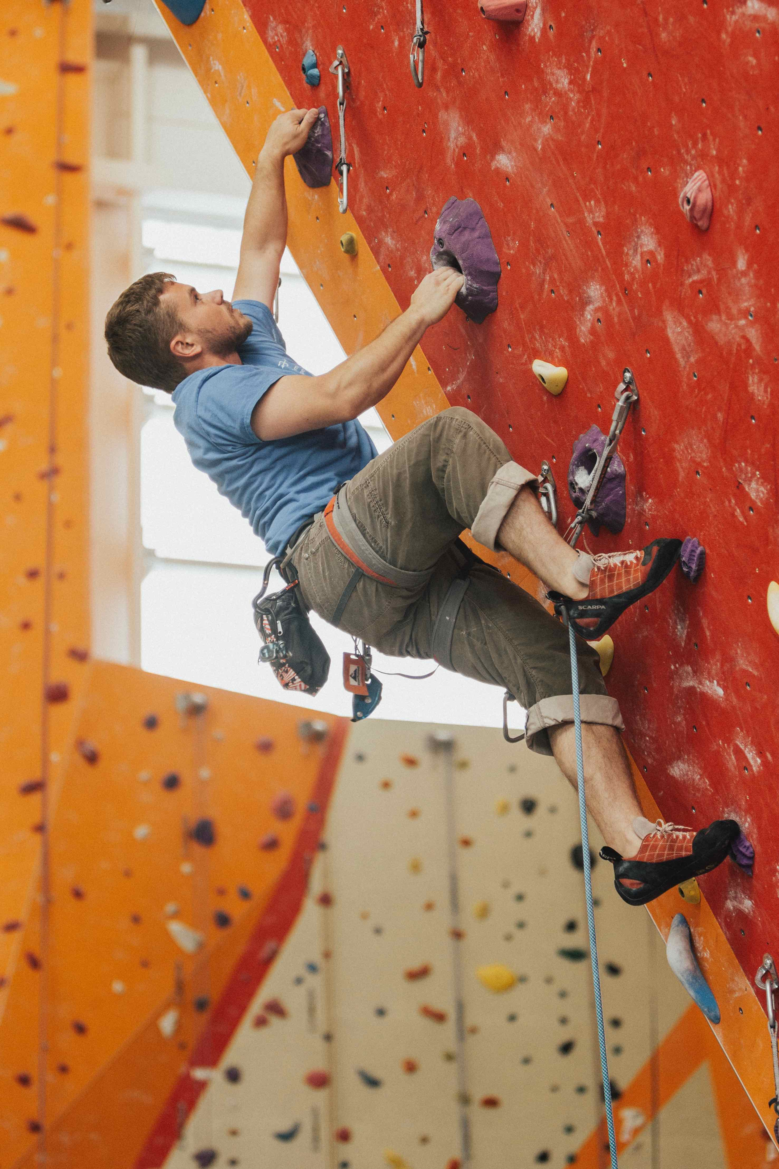
Starting point #1 : generic
The CSIRT work is a many faceted and challenging craft
CSIRT members need :
Communication skills
Technical skills and experience
Trust building skills ➔ human networks
Common sense
Creativity, thinking outside the box
At times: stamina
Photo by roya ann miller on Unsplash
Notes:
Trainer: shortly explain all 6, and the order: of course you could change the order slightly, it’s not meant to be cut in stone. To most of these aspects the training will come back.
Creativity and trsut building are probably the factors that make the CSIRT craft so fascinating and are certainly important reason that people keep coming back to the CSIRT community.
Explain that “trust” is based on interpersonal relationships – NOT on organisational bonds, or on x509 certificates, etc

Slide 12
Starting point #2 : terminology
CERT : Computer Emergency Response Team
Origin 1988, later trademarked
CERT Coordination Center (CERT/CC)
Permission to use : http://www.sei.cmu.edu/legal/permission/index.cfm
CSIRT : Computer Security Incident Response Team
Origin 1998 : http://www.cert.org/archive/pdf/csirt-handbook.pdf
Free to use !
IHT, SIRT, CIRT, IHC, SOC (a story in itself), etc. etc.
What’s in a name – you must have this capability !
Notes:
Kossakowski, Stikvoort and West-Brown created the term “CSIRT” in 1998 to avoid the trademarked “CERT” – thus CSIRT was first launched in the 1st version of the CSIRT Handbook.
Trainer: explain SOC and how it can relate to CSIRT.
{ to-do for authors: develop separate slide on SOCs }

Slide 13
Starting point #3 : SIM3
SIM3 = Security Incident Management Maturity Model
For (self) assessment,
membership criteria &
certification purposes
44 parameters in 4 categories
O – Organisation : 10 (O-6 “intentionally blank”)
H – Human Aspects : 7
T – Tools : 10
P – Processes : 17
Organisation
Human
Tools
Processes

Slide 14
SIM3 Scores
Each parameter can score :
0 = not available / undefined / unaware
1 = implicit : “between the ears only”
2 = written down but not formalised
3 = like 2 but approved by CSIRT head : “rubberstamped” (or published)
4 = like 3 but actively assessed or audited on authority of governance levels above the CSIRT management on a regular basis
Diagram courtesy OCF

Slide 15
Starting point #4 : FIRST services frameworks
FIRST CSIRT Services Framework
https://www.first.org/education/csirt_service-framework_v1.1
FIRST PSIRT Services Framework
ditto for product security teams (PSIRTs) – to be published
These frameworks enumerate in depth the kind of “services” that a CSIRT or PSIRT can deliver to their constituencies (their clients)
This is an amplification of the SIM3 parameters O-5 and O-7
SIM3 and the service frameworks are “orthogonal”: SIM3 describes the whole range of 44 maturity parameters for a CSIRT – the service frameworks are an in depth survey of 2 of those parameters
Notes:
FIRST PSIRT Services Framework yet to be published – expected soon
{ to-do for authors : insert orthogonal SIM3/services pic }

Slide 16
Basics & Exercise
Basic concepts leading into a group exercise
Notes:
Trainer: we are still in the What section.

Slide 17

For your CSIRT to make sense you must understand your organisation
Incident management is about your organisation !
It’s not primarily about computers, routers and networks
It is about you and your boss and the receptionist and all others, it’s about your products and services, it’s about your customers and shareholders
Your CSIRT wants to prevent and cure incidents
So you need to know and understand your organisation
Hierarchy: How do units relate? Who is in charge?
Maze: Who are the key people you need to persuade?
Photo by Larisa Birta on Unsplash
Notes:
Trainer : in regard “maze”, realise that in (most) any organisation there are key people who are not managers. Often, experts who have been around for a long time, and are just not the “manager type” (often they tried a function like that and didn’t like it). Get them on your side – their influence is unseen but real. And by the way – if you want to get anything done in an organisation, be aware that in a different way, secretaries are key people too ... you could ask the students why that is the case.

Slide 18
Security Management Cycle
Make sure you implement a cycle like this
DO the feedback and ensure FOLLOW UP
CSIRT can contribute to …
Risk Analysis
Security Plan
Evaluation
Security Policy
Risk Analysis
Security Plan
Implementation
Feedback
Audit & Evaluation
Diagram courtesy S-CURE
Notes:
Trainer : it happens regularly that the feedback loop leads to costed proposals – that then get delayed a year or more due to budgeting cycles. Make sure that in the budgeting there is a reserve for implementing security improvements: these are not optional in many cases!
CSIRT members can make important contributions to the cycle as they know what can go wrong and what went wrong – this is invaluable knowledge and experience.

Slide 19
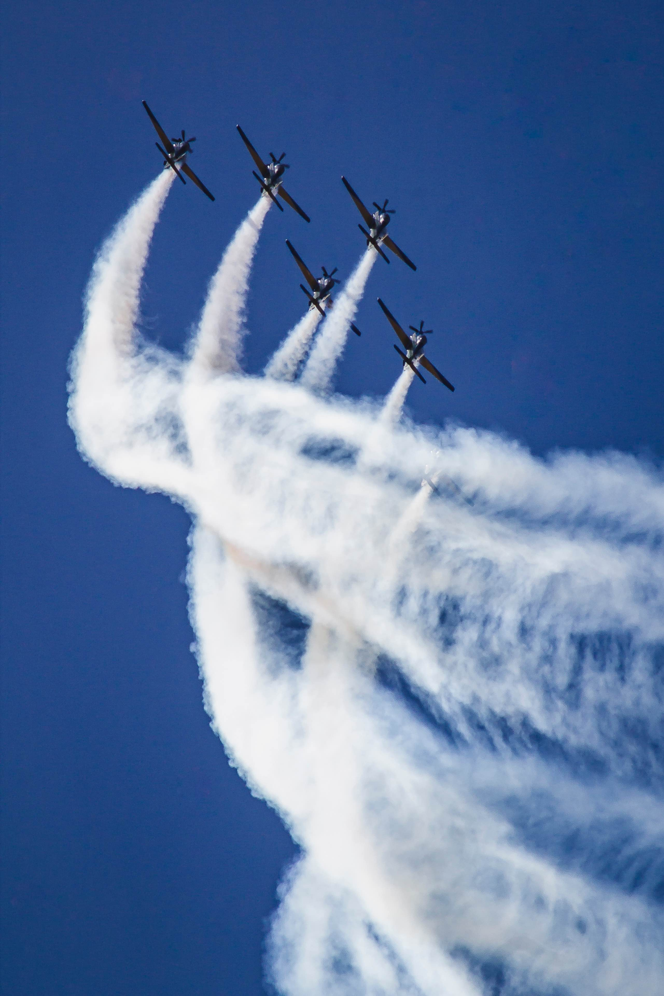
Organisation of security
“Security is not a product it is a process” – Bruce Schneier
See security as a holistic challenge – not fragmented
“integrated security”, “TSM” etc.
Information security has many actors
CISO
CSIRT
IT department & SOC
Physical security
Risk Management
Crisis Management
Business continuity Management (BCM)
End-responsible = board / CEO
Photo by María Noel Rabuñal Cantero on Unsplash

Slide 20
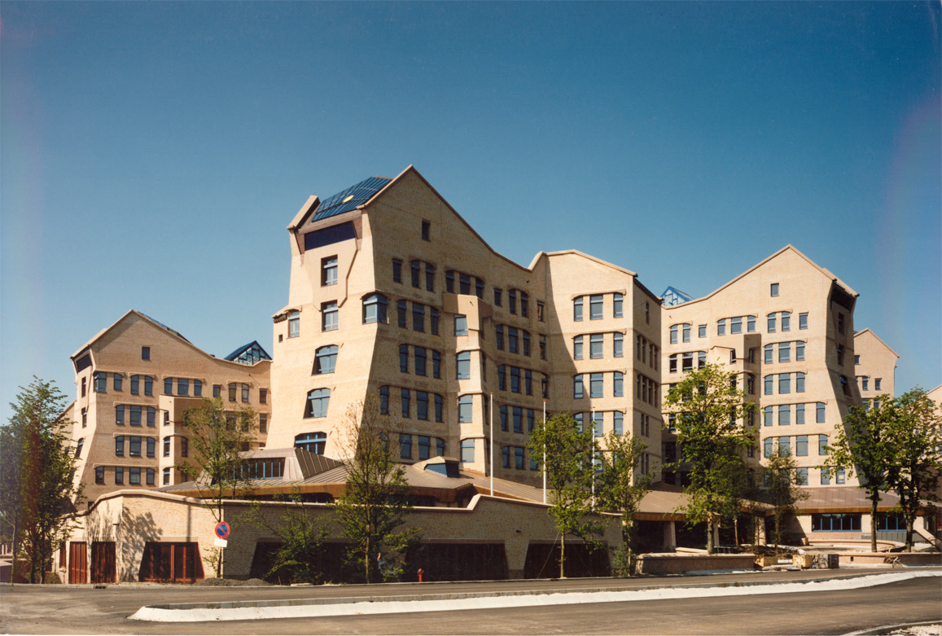
CSIRT as spaceship
Board
Accountancy
IT
CSIRT
Physical
Security
Diagram courtesy S-CURE
Notes:
Trainer: explain that this organisation pic lacks the departments/divisions/faculties – it’s a diagram intended to point out the importance of the board (end-responsible for security), accountancy (checking not only on money but more and more also on the organisation of IT and security), physical security (visible to board members, unlike infosec) – and IT. IT usually includes the CSIRT though the CSIRT can also be a staff function. The CSIRT is however unique in that it WORKS FOR THE WHOLE ORGANISATION and needs to be able to contact most of that organisation. That’s why the image of the “CSIRT as spaceship” is so apt: the CSIRT is like a spaceship that can fly through the whole organisation - unlike normal functions of IT, that are hierarchically embedded, is the CSIRT in some ways like a “free radical” – a spaceship indeed.

Slide 21
Example: PariSto Bank
CEO
Director France
Director Sweden
CIO
CISO
Head of IT
Head of IT
CSIRT
?
Head Networks & Systems
Head Networks & Systems
Sysadmin
CSIRT
?
Diagram courtesy S-CURE
Notes:
Trainer : the PariSto bank does not exist, invented many years ago by Don Stikvoort. This bank has just discovered it needs a CSIRT, e.g. because of e-banking having started (many midsize and smaller banks don’t have CSIRTs yet). The board has tasked the CISO with forming the CSIRT – and the CISO is wondering whether to do that at the c-level (in the c-level building), or somewhere in the IT departments of France or Sweden. All these options are feasible and have pros and cons, that the students will discover in the exercise that is to follow.

Slide 22
Exercise (30 minutes)
Split into groups of 3-4 (no same org people in same group)
In each group :
One member make some notes for wrap-up
Choose one of your CSIRTs and discuss (= exercise purpose)
Mandate : how and by whom was your CSIRT mandated ?
Constituency : who do you work for ?
Authority : what is your team allowed to do ?
Responsibility : what is your team expected to do ?
Services : what services does your team offer to the constituency ?
Structure of team : central/distributed ? Experts on-call ? ( Timezones ? )
Place of team in organisation : where do you fit in ? Does this set-up work well ?
Plenary wrap-up (discuss only highlights of group discussions)
Notes:
Trainer: the plenary wrap-up is not meant to get all the answers from each group – this takes too long and is boring. If there is time, ask each group to highlight ONE (at most 2) interesting aspect of their discussion. Every now and then you will have to – nicely and politely – stop students who still want to tell everything they have discussed in their tracks and get them to focus on the highlights.
By the way, this exercise leads from the What into the How (4-mat).

Slide 23
Organisational Factors
The main organisational factors to bear in mind
Notes:
Trainer: we are now in the How section.

Slide 24
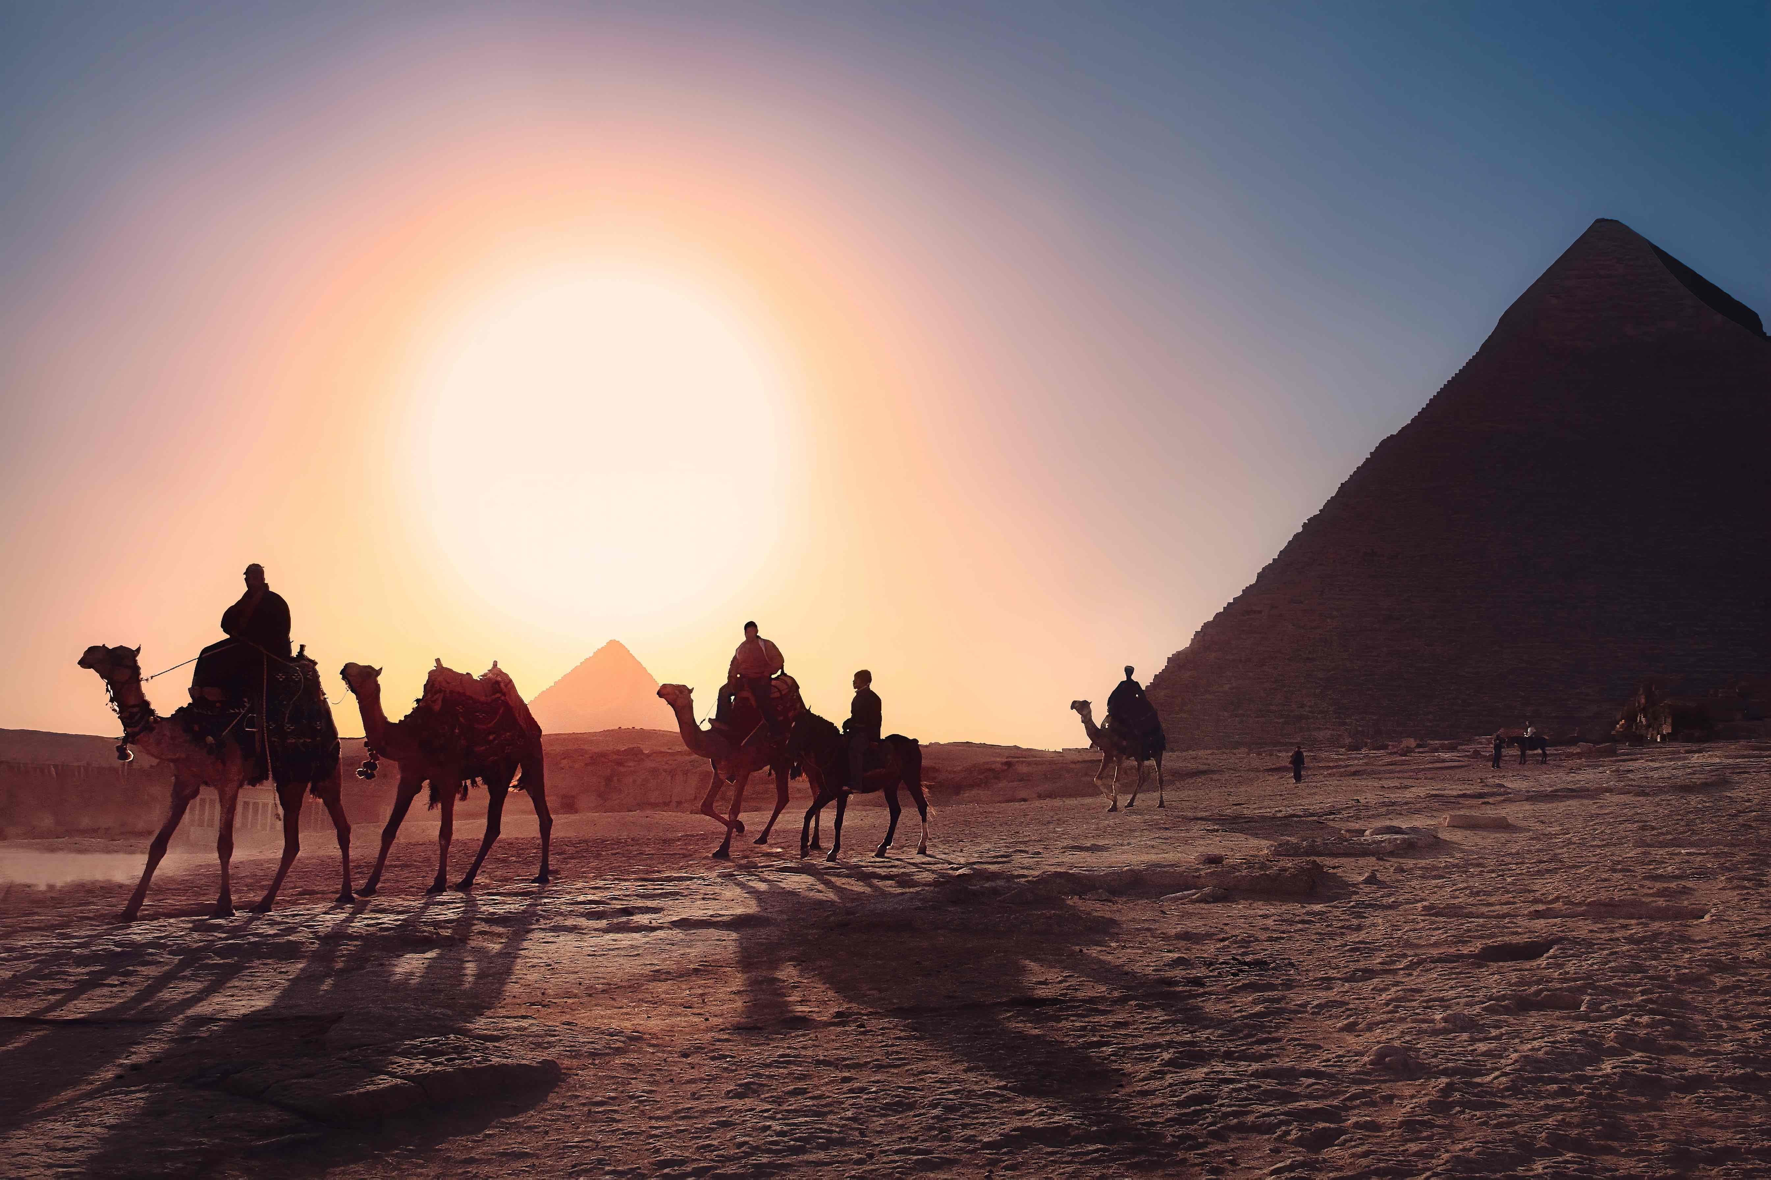
Mandate: SIM3 O-1
CSIRT Mandate should come from Board level
For national teams best anchored in legislation
And/or national cyber security/resilience policy
Funding also needs to be anchored at high level to ensure continuity
Photo by Simon Matzinger on Unsplash

Slide 25
Constituency: SIM3 O-2
Who does your CSIRT work for, what is the target group ?
Main types of constituencies:
National/CII : serving the country, or at least the critical infrastructure
Sector : serving a specific sector like e.g. the energy sector (usually inside a country)
Government
Military
Academia : serving universities, research institutes, schools, libraries, etc.
Own organisation/corporation : most commonly found all over society/business
Paying customers : offering commercial CSIRT services
PSIRTs (Product Security Incident Response Teams) are special case
Notes:
Trainer: CII = Critical Information Infrastructure

Slide 26
Authority: SIM3 O-4
Authority – what is your team allowed to do
Advise only ?
Power of escalation ? - you need that if you can’t enforce …
Power of enforcement ? (e.g. blocking)
Authority must come from highest governance level (not from head of IT)
Have a “CSIRT charter” document approved and rubberstamped
CISO role is intermediary between CSIRT and Board
Authority is not the key factor to success, but it can help. Al Capone: a gun and a good argument is better than just a good argument !
Notes:
LACKING:
Punishment/repression is not a CSIRT task
but CSIRT will contribute when necessary (follow strict procedures!)

Slide 27
Responsibility: SIM3 O-4
reactive :
Incident handling
Alerts & warnings
Vulnerability handling
Artifact handling
pro-active :
Announcements
Technology watch
Audits/assessments
Tools maintenance
Security tool development
Intrusion detection
quality management :
Risk analysis
Business continuity planning
Security consulting
Awareness building
Education/training
Product evaluation/certification
No team is responsible for all of these !
List from CERT/CC and ENISA : https://resources.sei.cmu.edu/asset_files/WhitePaper/2002_019_001_53048.pdf
Notes:
Trainer: this is the old services list from the CSIRT Handbook, used by CERT/CC on their website – and also by ENISA. They are not presented as services here, to give room for the FIRST CSIRT Services Framework on the next slide. However this old list is still a useful checklist to see what a team is responsible for, and what not. Hence used in this context. You can also refer to it as an alternative (older) list of services, if you wish.

Slide 28
Services: SIM3 O-5
FIRST CSIRT Services Framework
https://www.first.org/education/csirt_service-framework_v1.1
Service areas: (subdivided in services and then functions)
Security Event Management
Incident Management
Cyber Threat Intelligence Management
Vulnerability Management
Knowledge Transfer
rfc2350 : strong advice to fill it out
Operational factsheet of your CSIRT (services and contact data)
Place on your team’s webpages
Notes:
Trainer:
the service areas mentioned are from the new version of the framework to be made public June 2019. The reference is still for the old version – needs to be replaced as soon as the new version becomes available, as this has different service areas (lacking logic)
explain why rfc2350 should be filled out and made public, in English (plus native language, if you like).

Slide 29
Service cycle
Incident prevention
Awareness raising, audits, port and vulnerability scans, advisories, …
Incident detection
IDS sensors, firewall alerts, point-of-contact, …
Incident resolution
Incident co-ordination, on site handling, …
Incident quality management
Team meetings, lessons learnt, recommendations, …
Feeds back to incident prevention

Slide 30
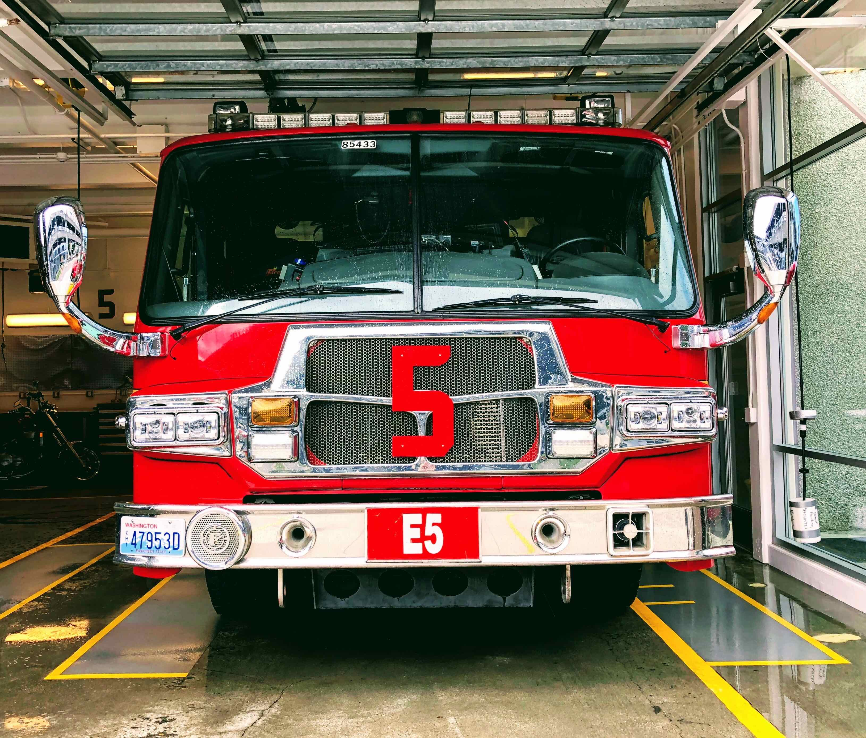
CSIRT core service(s)
Incident Management : essential function for any CSIRT
May consist of any or all of :
Incident response coordination
Incident response support
Incident response on site
Incident analysis
Forensic evidence collection
Tracking
However … always remember to establish lessons learnt and feed them back to incident prevention
Photo by John Cameron on Unsplash

Slide 31
PSIRT core service
PSIRTs deal with broken things
FIRST PSIRT Maturity Document recommends starting with:
Vulnerability Management Policy (as covered in ISO30111)
Information Handling Policy (as covered in ISO/IEC 29147)
Vulnerability Scoring/Prioritization Policy
Remediation Service Level Agreement
Vulnerability Disclosure Policy (usually a public documentation)
See https://www.first.org/education/PSIRT-maturity-document.pdf
Notes:
Trainer : PSIRTs deal with vulnerabilities in the products sold by their host organisation. Think “Patch Tuesday”. So their services will revolve around detecting, assessing and remediating vulnerabilities.

Slide 32
Service Level Description: SIM3 O-7
When is the service provided ?
24/7 : expensive & only useful when also applies to IT operators
Office hours only : 09 to 17, 08 to 20 or similar
Out of hours coverage
For emergencies only (who decides?)
Best effort is always better than no effort
Other service levels
Dependent on incident classification ?
(Human) reaction time
Resolution time : be very careful
Notes:
Trainer : be very careful with defining service levels based on resolution times as the graph of the number of incidents vs the resolution times is not a Gauss curve, it’s asymmetrical: a small percentage of problems stays open a very long time, making the average resolution time much longer than you would expect. You could replace this by a service level like: 90% of the incidents needs to be solved within so-and-so-much time - that allows the remaining 10% to hold those cases that take a long time in solving (often due to factors outside the power of the team).

Slide 33
Incident classification: SIM3 O-8
How do you technically classify incidents ? ( = taxonomy )
Classical taxonomies focus only on incident types. A good example is the popular eCSIRT.net / ENISA taxonomy : https://www.trusted-introducer.org/Incident-Classification-Taxonomy.pdf
More modern approaches also take impact/cost (and/or priority) into account. See e.g. https://www.thecroforum.org/2016/06/20/concept-proposal-categorisation-methodology-for-cyber-risk/
Classification can be used for reporting, planning (including writing processes) and for service levels
Incident Types
Incident Categories
Incident Severity
Incident Classification
Notes:
Trainer : explain that higher impact incidents usually need a higher level of service (faster handling, at least). In older classifications without impact this can also be reached by for instance prioritising certain types of incidents, like a DDoS

Slide 34




National and International Cooperation: SIM3 O-9
Notes:
Trainer: use this to stress the great importance of national (not in the images! but essential!) and international cooperation for CSIRTs. FIRST as worldwide forum is placed in the middle – note that this has nothing to do with some kind of CSIRT coordinating function. ITU and GFCE are also worldwide, ITU runs a CSIRT program, GFCE seeks to coordinate more on a higher political level, bridging the CSIRT community with the political levels.
As to ”regions”:
Europe : TF-CSIRT – but you could also add e.g. the EU cooperation of national teams, the CSIRTs Network
Africa : complicated … AfricaCERT is slowly gaining recognition but does not have the TF-CSIRT status yet. Emerging in Africa are existing regional NREN (academic networks) cooperations (there are 4 of those in Africa) who start cooperating on the CSIRT level too – WACREN is a particularly good example.
Latin America : via Lacnic there is good CSIRT cooperation – this used to be called Amparo, but is now named Lacnic Warp. The Organisation of American States (OAS) also runs a CSIRT program.
Asia-Pacific : the APCERT is a very successful cooperation, but only for national teams.
Not quite a region, but also worth mentioning: OIC-CERT, the CSIRT cooperation of the Organisation of the Islamic Cooperation

Slide 35
CSIRT charter: SIM3 O-10
Write a charter (organisational framework) for your CSIRT
Essential to clearly define your CSIRT and prevent discussions when incidents happen
High level description
Mandate, constituency, authority, responsibility, services, structure & place of team
“CSIRT Handbook” is good background material : http://www.cert.org/archive/pdf/csirt-handbook.pdf
Example NCSC-NL : https://www.ncsc.nl/english/organisation/about-the-ncsc/operational-framework.html

Slide 36
Charter: structure of team
Central (most common)
CERT-BDF (serving Banque de France)
Distributed
SURFcert (serving SURFnet, Dutch NREN)
TS-CERT and “sub-CERTs” (serving TeliaSonera ISP)
Timezone distributed (very rare)
Cisco PSIRT (Cisco’s product security team) “follows the Sun”
ThaiCERT (serving Thailand: government & national)
MSCERT (Microsoft PSIRT: in Redmond)

Slide 37
Charter: place of team in organisation
Most common : part of IT department
Remember : CSIRT is a spaceship
Mission and authority must be anchored at highest governance level
Ensure good working relationships & direct escalations with :
Your constituents e.g. through established contacts in all departments
Line management (your boss)
Highest governance level e.g. through CISO
PR staff (press contacts)
Legal department & privacy officer
Sometimes : organisation support function
Great place to be for mandate, authority and escalations
But: leave your ivory tower !

Slide 38

Security Policy: SIM3 O-11
Typically a formal approach
ISO27001
National standard
NIST Cybersecurity Framework
Preferably (also) have your own CSIRT security policy
CSIRT has special needs
Testing, port scanning
Honeypot
Extra fallback facilities
Security policy = SIM3 parameter O-11
Photo by Ahsan S. on Unsplash

Slide 39
Human Factors
The main human/personnel factors to bear in mind
Notes:
Trainer: we are still in the How section.

Slide 40
Exercise (20 minutes)
Split into same groups of 3-4 as before
In each group :
One member make some notes for wrap-up
Choose one of your CSIRTs and discuss (= exercise purpose)
What challenges do you face in meeting your requirements for staffing ?
Do you know the skillset for the staff you need and have appropriate job descriptions ?
Do you have access to training / training budget for your staff ?
Can you effectively escalate (also outside business hours) to a) your own boss, b) the higher governance levels, c) the press handlers, d) your corporate lawyer(s) ?
Plenary wrap-up (discuss only highlights of group discussions)
Notes:
Trainer: the plenary wrap-up is not meant to get all the answers from each group – this takes too long and is boring. If there is time, ask each group to highlight ONE (at most 2) interesting aspect of their discussion. Every now and then you will have to – nicely and politely – stop students who still want to tell everything they have discussed in their tracks and get them to focus on the highlights. If there is not enough time select the questions that they need to cover, e.g. leave out the 4th one.
{ authors to-do : make a slide about the escalations which ties into SIM3 P1 – P3 – unless covered by new operational module }

Slide 41
Code of Conduct: SIM3 H-1
The human factor is the prime factor in the success of any CSIRT - Without a good, trustworthy team … nothing goes
Trust is one of the key factors in successful CSIRT cooperation
Your CSIRT takes at least a year to build trust and can lose it overnight
Trust is built on personal relationships, not on organizational ones
Avoid hiring ex(?)-crackers
Use a Code-of-Conduct and discuss it with your team each year : e.g. https://www.trusted-introducer.org/TI-CCoP.pdf
TLP - Traffic Light Protocol : active knowledge and use required : https://www.first.org/tlp/
“Who polices the police” applies to CSIRTs too
Notes:
Trainer : “who polices the police” (we are talking about CSIRTs here, NOT the real police! Hence the quotes) was inserted because of a recent situation (in Europe) where an investigation by a CSIRT of a case involving sexual harassment was stopped – as it turned out possibly due to a conflict of interests. Who do you turn to in such a case? Undefined. This is unmapped territory. Worthwhile discussing with students if there is enough time.

Slide 42
Personnel Resilience: SIM3 H-2
Need enough team members to cover for holidays/illness
SIM3 says minimum 3 (can also be part-timers)
Burnt-out team members are not effective
Always have a plan B (discussion)
CSIRT work can be challenging – what to compensate
Offer appropriate rewards
Keep work varied
Budget for trainings
Let staff attend events
Notes:
Trainer : SIM3 calls this indeed “personal resilience” but that’s simply a language error – should be ”personnel” or “staff” resilience. This will be corrected in the next SIM3 version (says the OCF who governs and maintains SIM3). Also trainer, DISCUSS the plan B with the students! Don’t spell it for them, let them think about it out loud in the group. If there is enough time, can do as short 7 min exercise in groups, then wrap-up plenary.

Slide 43
Skillset: SIM3 H-3
What skillsets are needed?
General: common sense, communication, diplomatic, quick learner, stress resistant, team player, integrity, owns up to mistakes, problem solving, time management, …
Technical: to match what the CSIRT offers
Skillset description for each job profile
(Senior) incident handler, researcher, general manager, …
Need other resources ?
Specialist skills (e.g. forensics), legal, crisis management, …
Arrange before an emergency hits
Notes:
Trainer : skills depend on your site infrastructure and you may be able to recruit from existing support staff. Plan for training and staff turnover.
Checking the history of recruits can be difficult and varies from country to country – often you have to just try them and see. Have defined procedures for joiners and leavers to regulate system access, if possible have them formally agree to workplace network monitoring.
It makes sense to re-use any existing teams if possible, indeed CSIRT teams will benefit from close working with network and IT teams.

Slide 44

Personal development ➔ team development
Personal development plan
Skills development: include soft skills
Budget & timeline
Feedback : commonly done by manager but consider having an experienced team member do feedback instead (less pressure, more coaching style)
Internal training = SIM3 parameter H-4
Technical training = SIM3 parameter H-5
Communication tr. = SIM3 parameter H-6
Photo by Martine Jacobsen on Unsplash

Slide 45
Training: SIM3 H-4, H-5 and H-6
Internal Training
Technical Training
TRANSITS
Communications Training
General Communications
Presentation skills
Speaking to press
Dealing with police
FIRST
ENISA
APNIC
Internal Tools
Team Building
Local Processes

Slide 46

Human communication
THE MEANING OF COMMUNICATION IS
THE RESPONSE YOU GET (= the result)
Photo by Icons8 team on Unsplash
Notes:
Trainer : this “writing on the wall” is actually one of the presuppositions of NLP – NLP is a useful set of tools that can help people communicate better. There are more approaches that work. It’s not about NLP or any approach here – but this presupposition stands out in all approaches.

Slide 47
Wrap-up
Notes:
Wrap-up and What-if section.
{ authors to-do: possibly extend using some of the old “how to build a team” slides. }

Slide 48
Stay in the picture
Stay visible for your constituency (also when you rock ! )
Presence on internal web pages (security, helpdesk)
Regular newsletters, workshops once or twice per year
Stay visible for Board and management
Quarterly and annual reports
War stories and statistics : add cost savings figures if possible
Stay visible for the world
Memberships of trusted for a
Your favourite regional forum ! (TF-CSIRT, APCERT, etc.)
FIRST : http://www.first.org/
Go out there : meeting face-to-face is essential for building web-of-trust and to help develop your team’s abilities

Slide 49
Common sense is vital in incident management
90% of your time can easily be wasted on 10% of the question. Prioritise, discuss with colleagues, focus on the desired outcome and damage control – incident handling is not scientific research.
“Habe Mut, dich deines eigenen Verstandes zu bedienen.” – have the courage to use your own mind ! (Immanuel Kant, 1724-1804)
Read some blog(s) and articles, e.g. Bruce Schneier, Brian Krebs et al.
Take nothing for granted, not even Immanuel Kant or your trainers here – nor your colleague who has done this work for 15 years
Notes:
Trainer : reference your favourite sources (along the lines of Schneier, Krebs – but your favourites, and why they are that)

Slide 50
Useful References
NCSC-cyber security assessments : https://www.ncsc.nl/english/current-topics/Cyber+Security+Assessment+Netherlands
Various reports: we all suffer from security incidents
Annual cost of global cybercrime
Symantec: $110 billion in 2012
McAfee: $ 600 billion in 2017 https://www.mcafee.com/enterprise/en-us/assets/reports/restricted/rp-economic-impact-cybercrime.pdf
Forbes: expected to reach $ 2 trillion by 2019 https://www.forbes.com/sites/stevemorgan/2016/01/17/cyber-crime-costs-projected-to-reach-2-trillion-by-2019/#6b99128b3a91
“Insider Threats as the Main Security Threat in 2017” https://www.tripwire.com/state-of-security/security-data-protection/insider-threats-main-security-threat-2017/

Slide 51
Reading List (1)
SIM3: https://www.trusted-introducer.org/SIM3-Reference-Model.pdf.
RFC2350: https://www.ietf.org/rfc/rfc2350.txt.
ENISA CSIRT Maturity: https://www.enisa.europa.eu/topics/csirts-in-europe/csirt-capabilities/csirt-maturity/csirt-maturity-self-assessment-survey.
Trusted Introducer Accreditation Package: https://www.trusted-introducer.org/invitation-package.pdf
Permission to Use CERT: https://www.sei.cmu.edu/education-outreach/license-sei-materials/authorization-to-use-cert-mark/.
CSIRT Handbook: https://resources.sei.cmu.edu/asset_files/Handbook/2003_002_001_14102.pdf.
Software Engineering Institute CSIRT Services: https://resources.sei.cmu.edu/asset_files/WhitePaper/2002_019_001_53048.pdf.

Slide 52
Reading List (2)
FIRST CSIRT Services Framework : https://www.first.org/education/csirt_service-framework_v1.1.
ENISA Reference Incident Classification Taxonomy: https://www.enisa.europa.eu/publications/reference-incident-classification-taxonomy.

